Slide 1
MEDICAL SHOP MANAGEMENT SYSTEM

Slide 2
ABSTRACT
The Project on Medical Shop Management System is to manage the details of Sells, Medicines, Stocks, Company , billing. It manages all the information about Sells, Medical Shop, Inventory, Sells. The project is totally built at administrative end and thus only the administrator is guaranteed the access. The purpose of the project is to build an application program to reduce the manual work for managing the Sells, Medicines, Medical Shop, Stocks. It tracks all the details about the Stocks, Company, Inventory.
The main objective of the application is to automate the existing system of manually maintained records of the counter sales, purchases, reorder levels, Supplier and Customer monetary positions and other related transactions made by the seller.
This application can be used by any other store to automate the process of manually maintaining the records related to the subject of maintaining the stock and liquid flows.The main goal of this project is that managing the medicine details, stock details and billing details very clearly. The project is aimed to develop by PHP as Front end and SQL as Back end.

Slide 3
HARDWARE SPECFICATION
Processor : P 4 700 GHz.
RAM : 4 GB RAM
Hard Disk Drive : 180 GB

Slide 4
SOFTWARE SPECIFICATION
Operating System : Windows 7/8/10
Front End : PHP
Back End : SQL

Slide 5
EXISTING SYSTEM
Currently, the medical works are based on the manual process, and each work is maintained in the paper. The details of purchasing drugs, audits, sell reports maintained on the paper while anyone can enter into the system and can make changes in these reports, so it is not a safe method to keep the information on the paper. The pharmacist faces problem in searching the products from the self as it is not an easy method to remember about the place of each medicine. There no Pharmacy Management System which can alert the pharmacist about the end of the drugs.
Disadvantages:
Can’t able to handle stock details
More number of resources can be handling single medical shop
It’s not user friendly for the customer
Customer need to wait long time for getting billing report.

Slide 6
PROPOSED SYSTEM
The design of the medical shop management system is based on the computer which will simplify the maintenance of the information, accessible and efficient. The Pharmacy Management System will provide the information about the end of the drugs in the medical so that the physician can order them drugs before the end. The pharmacist and nurses will get more accurate results at the time sell, about the details of the use of medicines and the dosages so that the system will become more reliable to use than the present system. The records of each work will be secure as to access the information the user must have to provide the ID and password in the system.
Advantages
Systematically provide all the details up-to-date.
Easily find the daily billing details
We can collect the all-customer details in single application.

Slide 7
Modules
Admin This module has access to create manager, only admin can able to create manager. The admin collects the managers details register manager entry. Once the manager has created, he gave access to login.
Manager
This module manager can create the cashier account, once cashier has created, he/she can able to login and register entry for billing details. The manager create account as well as for pharmacist.

Slide 8
Cashier
The cashier entered into the login and promote the billing. The main work for the cashier is for check the medicine and generate the bill and collect money.
Billing details
This module will show the all the billing details as a date wise, once the cashier collects the money and generate the bill it has to be shown in billing module. Manager or cashier can check the billing details for a date wise.

Slide 9
Customer Details
This module will be shown the all the customer details, this customer details has collected by the cashier before entering the bill. This module we can easily track the regular customer.

Slide 10
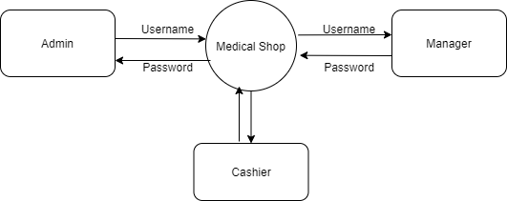
Data Flow Diagram
Level 0:

Slide 11
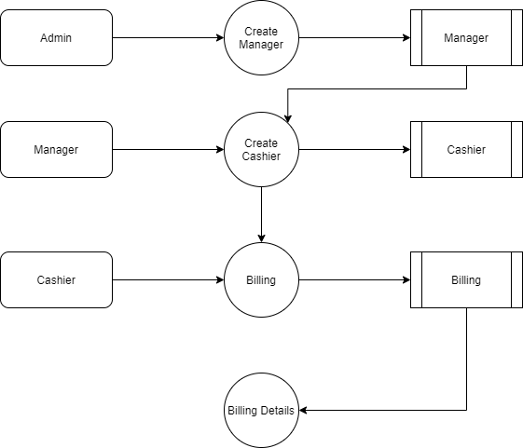
Level 1:

Slide 12
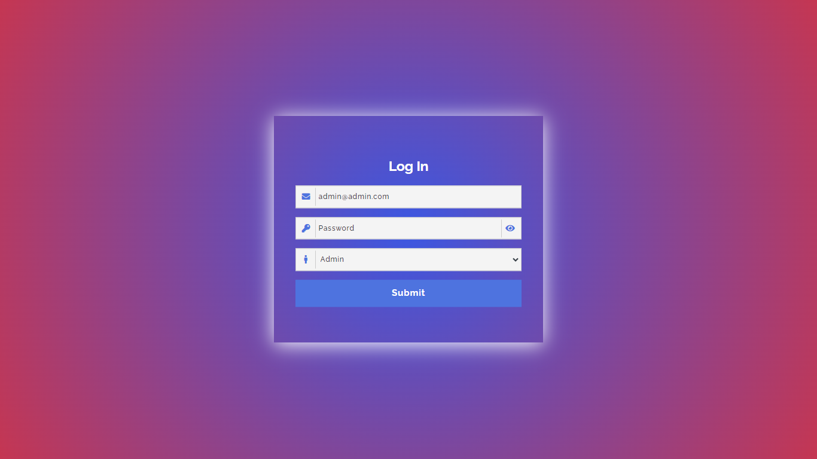

Slide 13
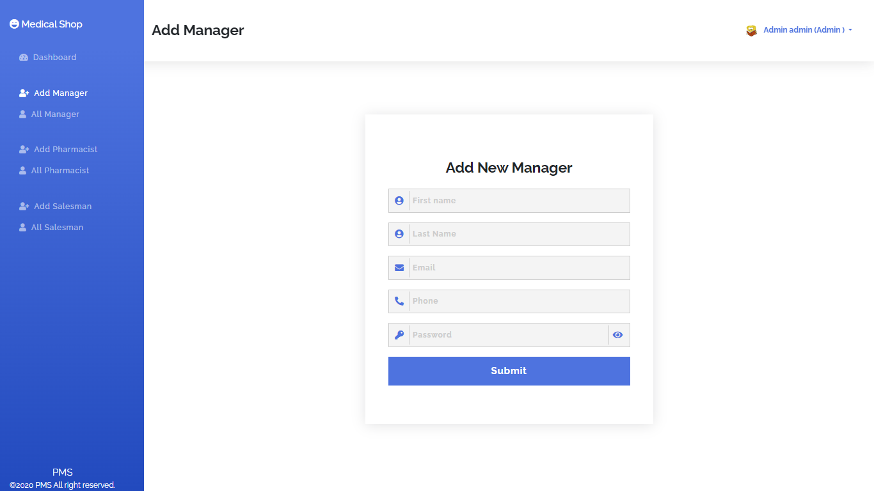

Slide 14
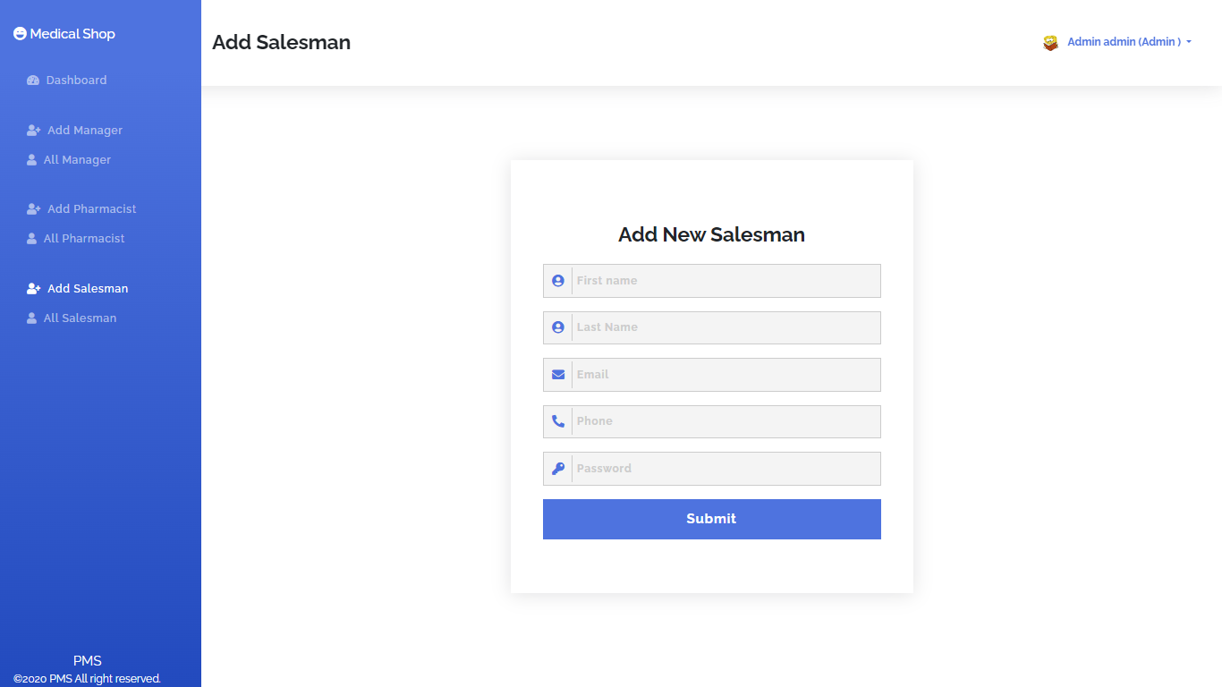

Slide 15
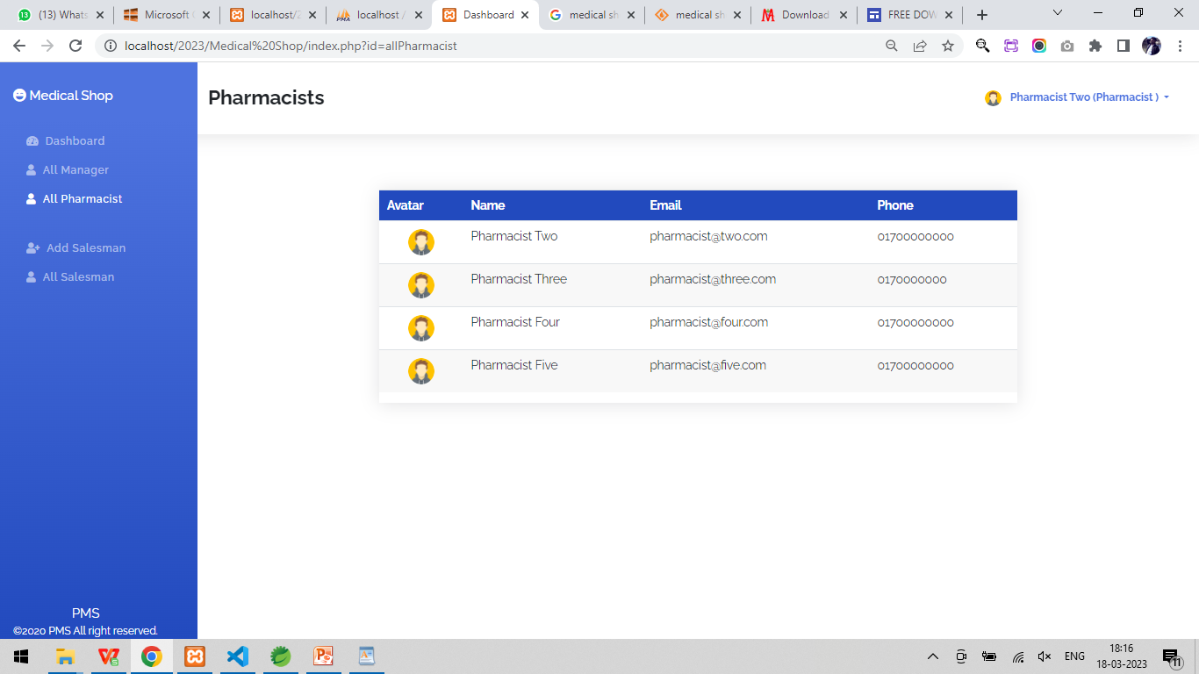

Slide 16
Thank You

